Slide 1
Gradient Descent
10/15/2025
Professor: Sitaram Ayyagari
By: Mahdi Mohammadkhani, Mohammad Uraib, Jesus Chavez

Slide 2
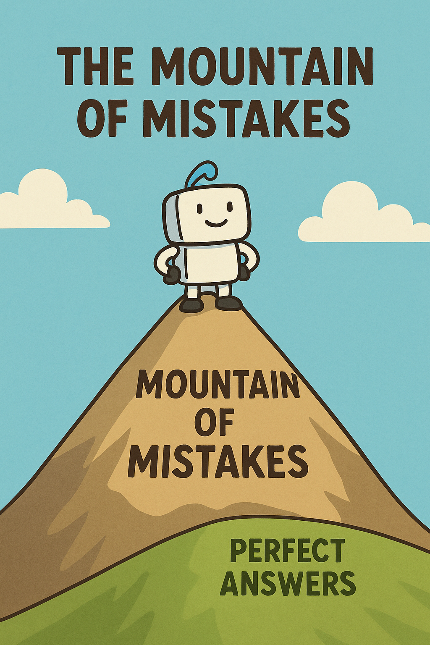
The Mountain of Mistakes
Meet Neuro the robot! He wants to find the best solution to a problem.
But right now, he’s on top of the Mountain of Mistakes!
To get the best answer, he must go down to the valley — the lowest point where mistakes are the smallest!

Slide 3
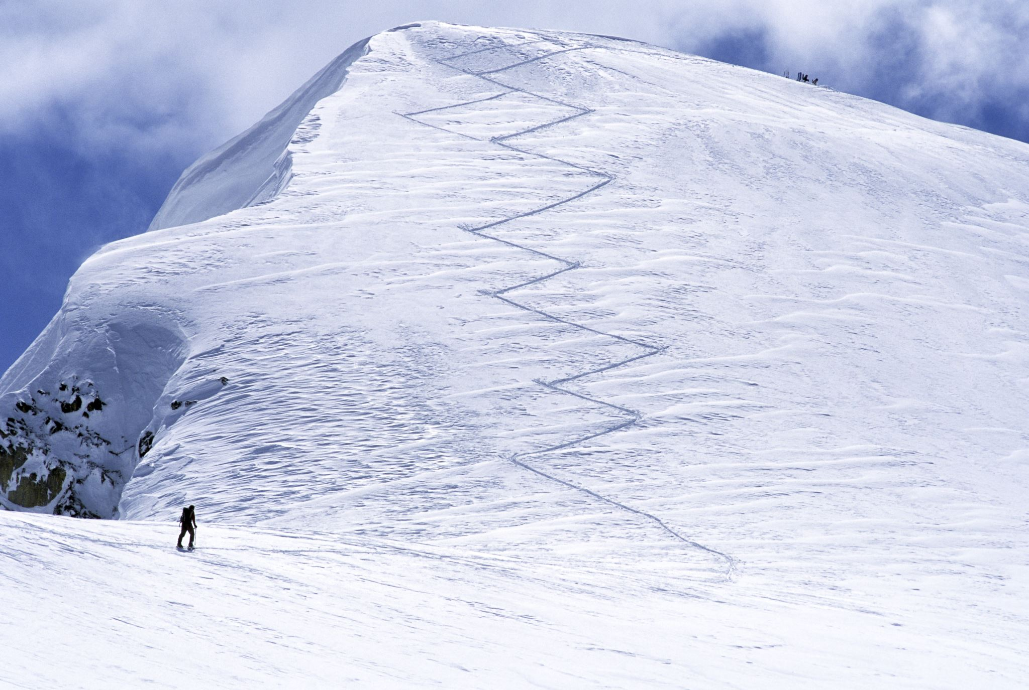
How Does Neuro Know Where to Go?
Neuro can’t see the whole mountain. He only knows how steep the ground is right where he’s standing.
So he takes small steps downhill, one at a time, following the slope.
Each step makes his answer a little better.
🧠 Gradient Descent means going downhill step by step to find the lowest mistake.

Slide 4

The Magic Formula (Simplified)
Neuro uses a simple rule:
1️⃣ Check which way goes downhill (that’s the 'gradient').
2️⃣ Take a small step that way (that’s the 'descent').
3️⃣ Repeat until he’s at the bottom (smallest mistake).
If steps are too big → he bounces around!
If too small → it takes forever!
He needs just the right step size — the 'learning rate.'

Slide 5
Why Is This Important?
Every time you ask an AI to recognize a picture or predict something, it’s using Gradient Descent!
It keeps adjusting its 'brain knobs' (weights) until it makes the smallest possible mistake —
just like Neuro reaching the bottom of the mountain.

Slide 6
Quick Recap
Gradient → How steep the hill is
Descent → Going downhill to reduce mistakes
Learning Rate → How big each step is
Goal → Reach the lowest point = best answer

Slide 7

Sources
• 'Deep Learning Illustrated' by Jon Krohn
• Andrew Ng, Machine Learning Specialization (Coursera)
• 3Blue1Brown: 'Gradient Descent Explained' (YouTube)

